Slide 1
Fitness Buddy
EDUNET FOUNDATION - IBM SKILLSBUILD
Presented By:
Amit Madeli ITER – Siksha ‘O’ Anusandhan University Computer Science & Engineering

Slide 2
OUTLINE
Problem Statement
Proposed System/Solution
System Development Approach (Technology Used)
Algorithm & Deployment
Result (Output Image)
Conclusion
Future Scope
References

Slide 3
Problem Statement
In today’s fast-paced and digitally connected world, many individuals face difficulty maintaining a healthy lifestyle due to time constraints, lack of personalized fitness guidance, and inconsistent motivation. Traditional fitness solutions often involve costly subscriptions, rigid schedules, or require in-person consultations that are not adaptable to each user’s unique preferences, routines, or fitness levels.
There is a growing need for an intelligent, accessible, and always-available solution that offers personalized workout recommendations, nutrition tips, and motivational support.
The Fitness Buddy project aims to solve this issue by developing a conversational AI-powered virtual assistant using IBM Granite-3.3-8B-Instruct and IBM watsonx.ai. This assistant will deliver real-time, tailored guidance on fitness routines, healthy meals, and habit-building techniques, making health and wellness support more convenient, engaging, and user-centric.

Slide 4
Proposed Solution
Proposed Solution: Fitness Buddy – AI-Based Virtual Fitness Assistant
Fitness Buddy addresses the challenges of maintaining a healthy lifestyle by offering an intelligent, conversational assistant that provides personalized fitness routines, nutrition tips, and motivational support—anytime, anywhere.
Data Collection
User data such as fitness goals, activity level, workout/diet preferences, and availability is collected. Contextual data like time of day, day of the week, and user consistency is also considered. Integration with wearables or logs can enhance personalization.
Data Preprocessing
Data is cleaned and normalized. Key features like workout frequency and intensity preferences are extracted. Users are grouped (e.g., beginner, intermediate) to guide tailored recommendations.
Machine Learning Algorithm
Using IBM Granite-3.3-8B-Instruct (LLM) via watsonx.ai Studio, the assistant interprets user input and context to generate customized plans. It adapts over time using previous interactions and feedback.

Slide 5
Proposed Solution
Deployment
The solution is deployed on IBM Cloud Lite with Watsonx Runtime Studio and Watson Assistant. It supports real-time interaction via web and mobile platforms with scalable cloud backend.
Evaluation
Effectiveness is tracked through engagement rates, feedback, recommendation accuracy, and retention. The system improves continually using updated user data and usage trends.
Result
A cloud-based AI assistant delivering real-time, personalized fitness and nutrition guidance—empowering users to stay healthy consistently and conveniently.

Slide 6
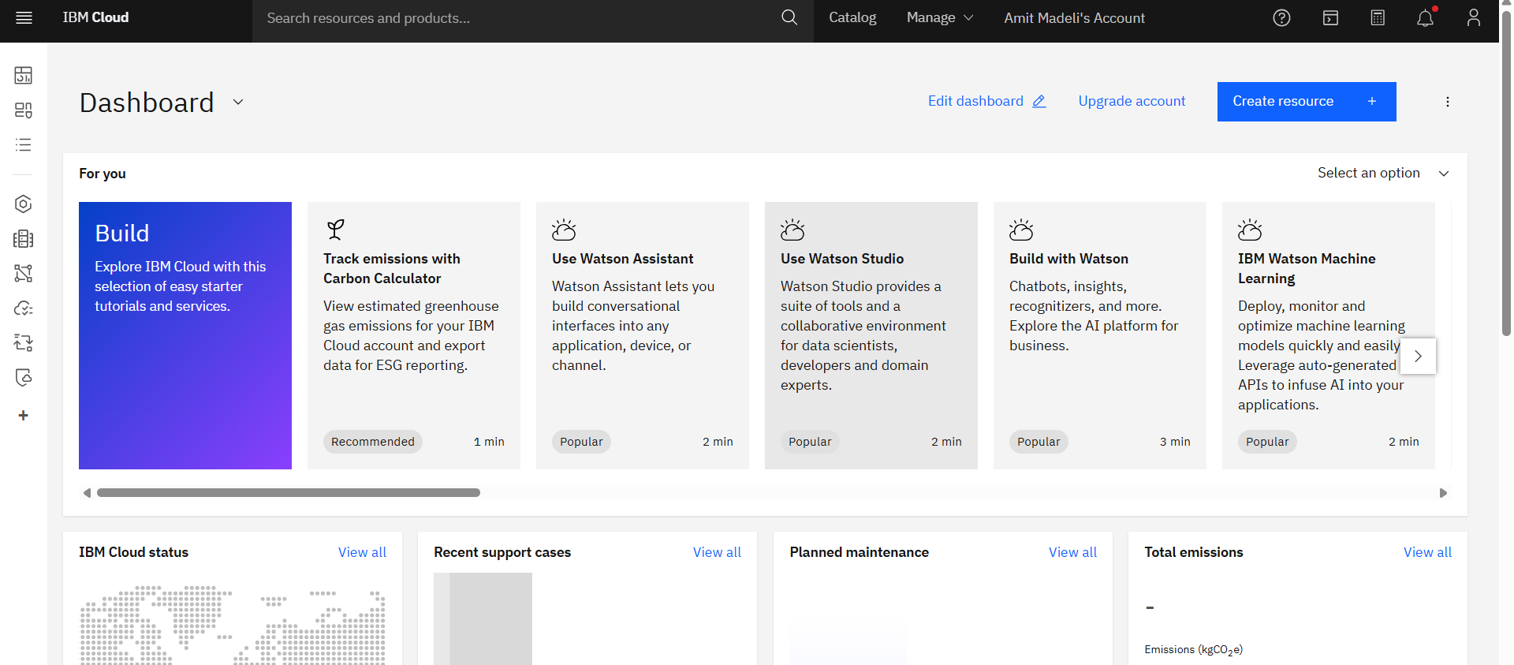
Proposed Solution
IBM Cloud Login

Slide 7
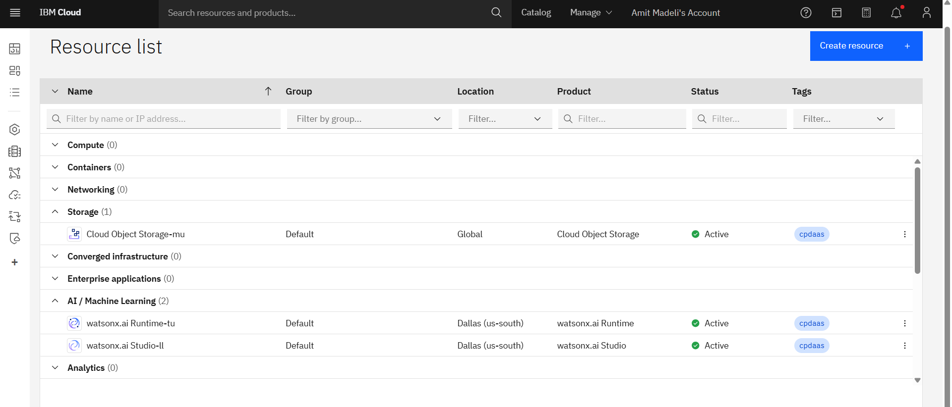
Proposed Solution
Resource List IBM Cloud : Storage using IBM cloud, watsonx.ai Runtime, watsonx.ai studio

Slide 8
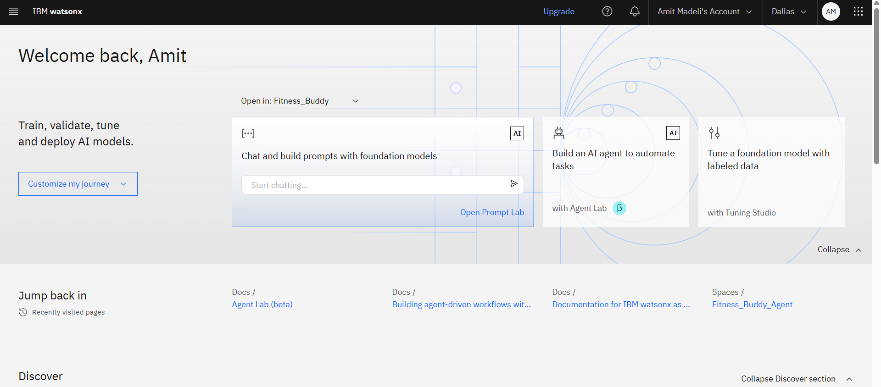
Proposed Solution
IBM watsonx.ai interface

Slide 9
System Approach
System requirements Processor: Intel Core i5/i7 (or AMD equivalent) RAM: Minimum 8 GB (Recommended: 16 GB for smooth model training/testing) Storage: Minimum 50 GB free space GPU (Optional but preferred): NVIDIA CUDA-enabled GPU (e.g., GTX 1660 or higher) for local training. Internet Connection: Stable broadband for cloud access and deployment
Library required to build the model IBM watsonx.ai Studio – Used to build, train, and manage the AI workflow and interactions. IBM Granite-3.3-8B-Instruct – The selected large language model for generating intelligent responses and supporting predictive capabilities. IBM Cloud – Provides the infrastructure to run and deploy the solution. Watsonx Runtime Studio – Acts as the execution environment for running the model over the cloud with high performance and scalability.

Slide 10
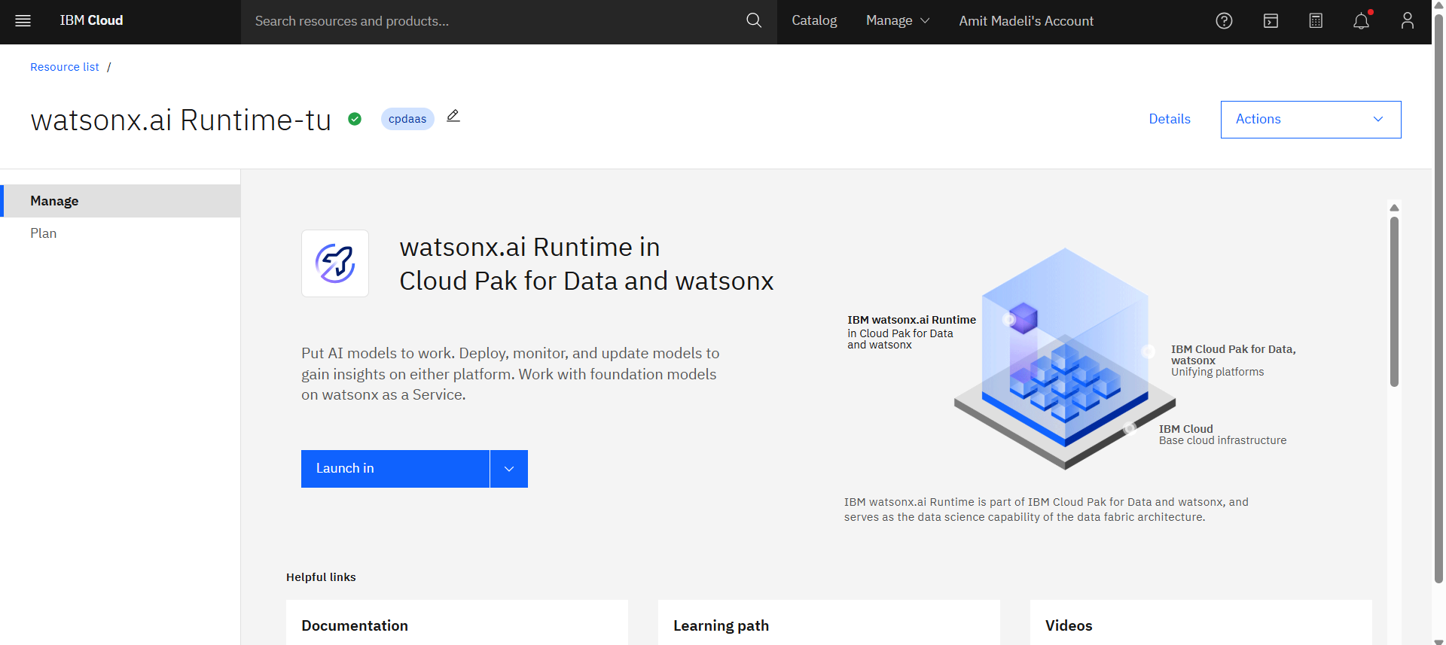
System Approach
Watsonx Runtime

Slide 11
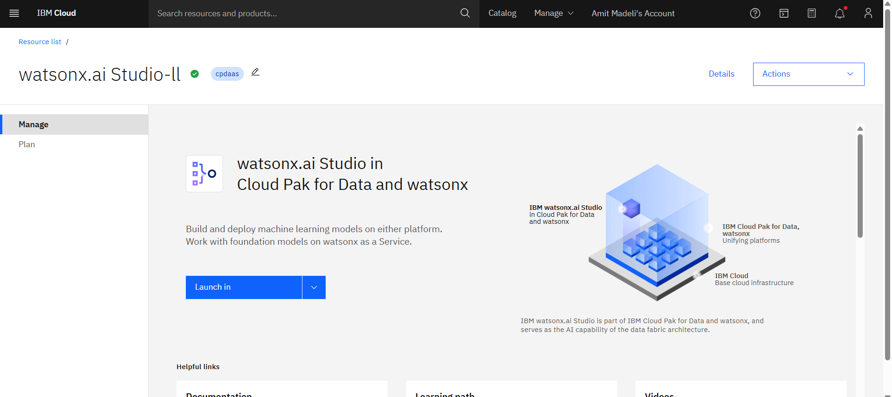
System Approach
Watsonx Studio

Slide 12
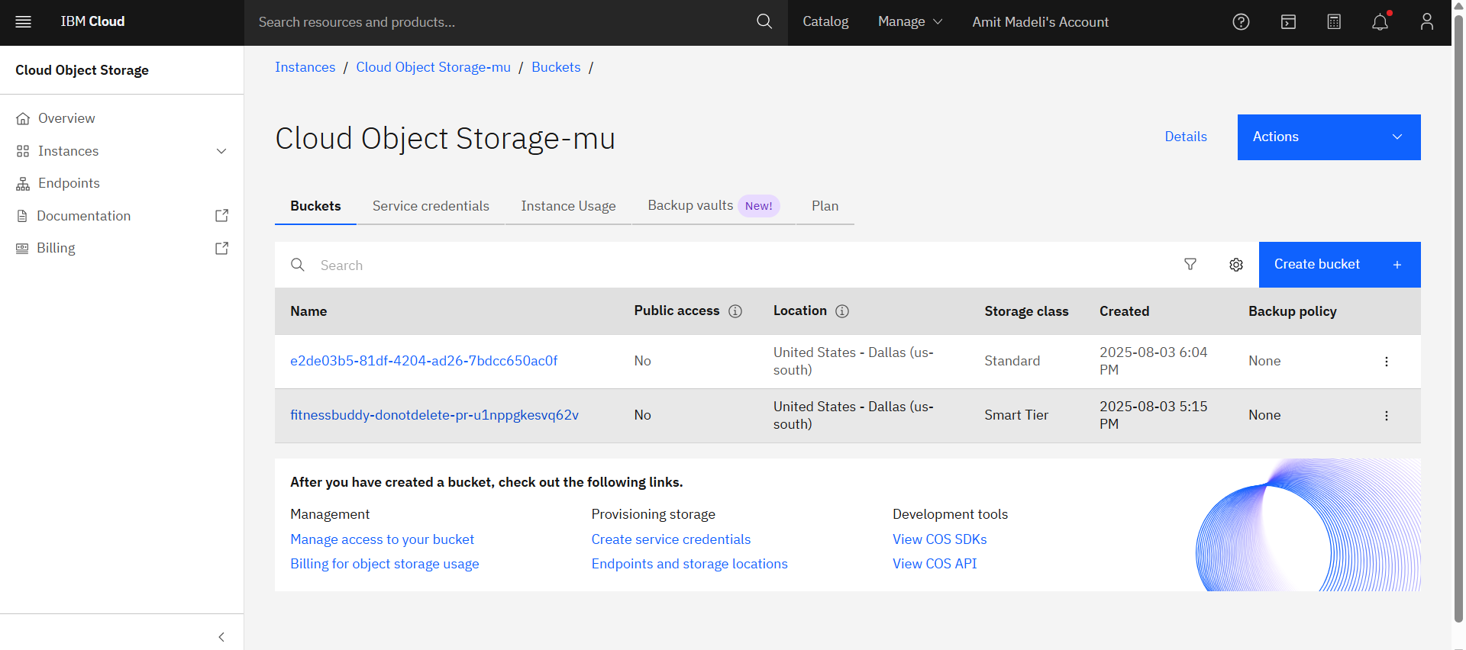
System Approach
IBM Cloud Object Storage

Slide 13
Algorithm & Deployment
Algorithm Selection:
The Fitness Buddy system leverages a Large Language Model (LLM) — specifically, IBM Granite-3.3-8B-Instruct — to deliver dynamic, context-aware fitness advice and recommendations. This LLM is capable of understanding user inputs in natural language and generating personalized fitness plans, motivational messages, and nutritional suggestions. It is selected due to its strong instruction-following ability, conversational fluency, and capability to adapt to diverse user queries, making it ideal for an AI health assistant.
Data Input:
The model utilizes user-provided inputs such as fitness goals, current activity level (e.g., beginner, intermediate, advanced), preferred workout types (e.g., cardio, strength, yoga), dietary preferences, and availability. It also considers contextual and behavioral data like time of day, day of the week, and consistency history. These inputs help tailor each session uniquely to the individual user.

Slide 14
Algorithm & Deployment
Training Process:
While the core LLM (Granite) is pre-trained by IBM, further customization is achieved by prompting and fine-tuning behavior through curated sample interactions and continuous feedback loops. Relevant prompt engineering techniques are used to optimize how the model responds to fitness-related queries. Continuous performance review, feedback rating, and iterative prompt adjustment act as an ongoing "training" process for system refinement.
Prediction Process:
When a user interacts with the assistant, their input is processed in real-time. The model dynamically interprets user context and intent, then predicts the most suitable response — such as a personalized workout, motivational message, or dietary suggestion. The system adapts over time based on usage history, enhancing relevance in future interactions. This form of prediction is generative and goal-aligned rather than statistical, making the LLM suitable for personalized, conversation-driven use cases.

Slide 15
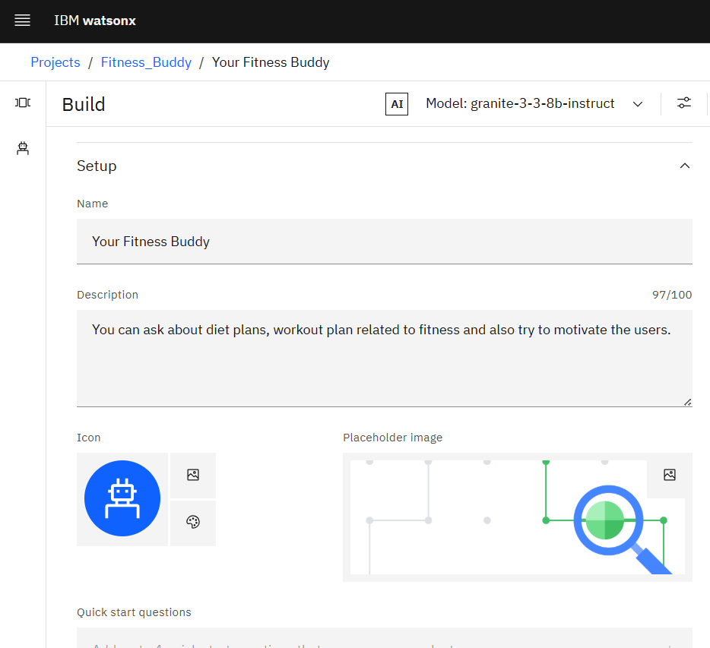
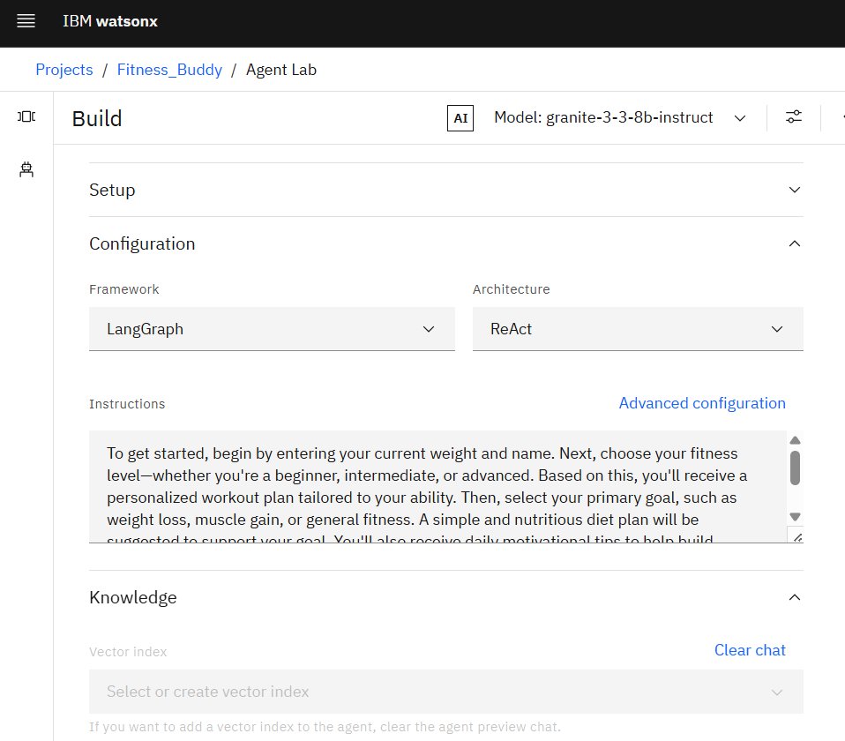
Algorithm & Deployment
Setting AI agent

Slide 16
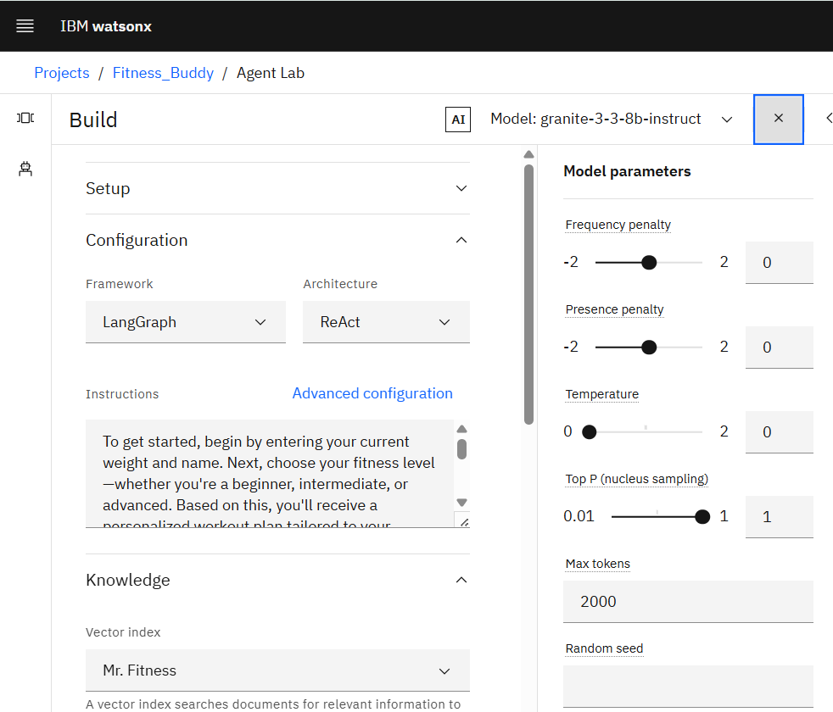
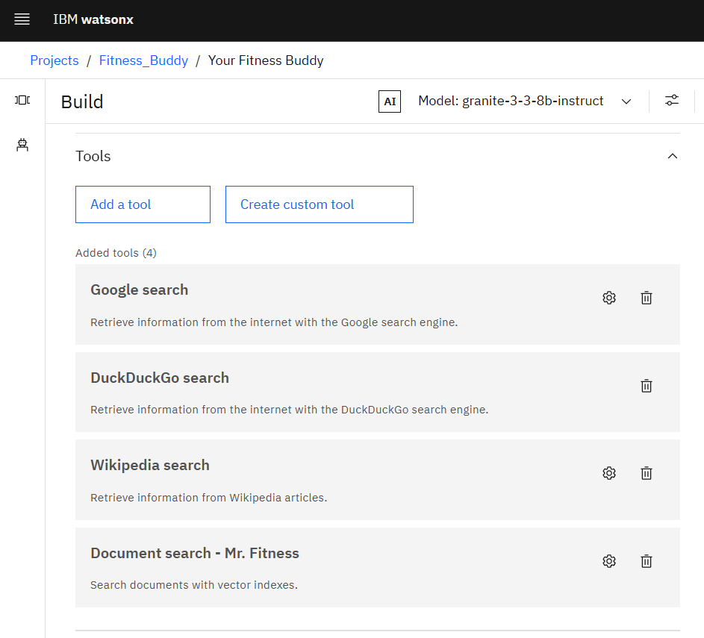
Algorithm & Deployment
Setting AI agent

Slide 17
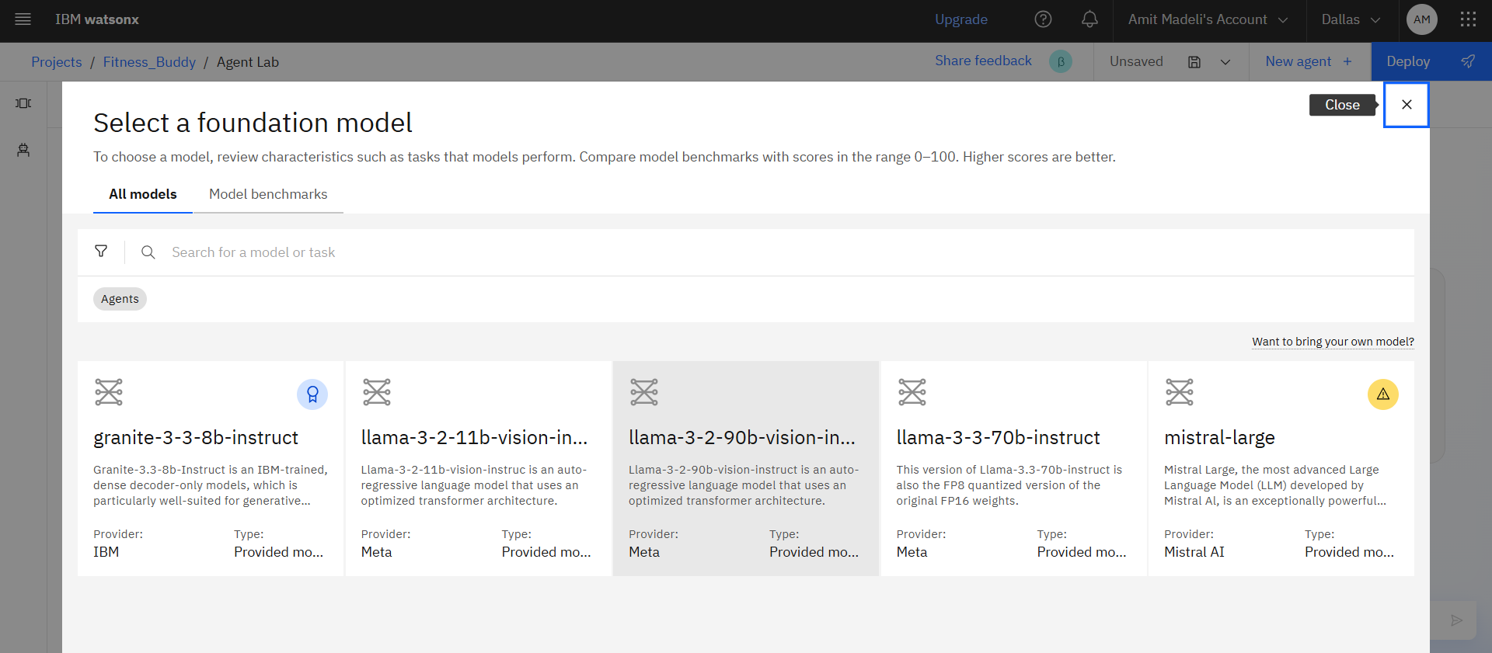
Algorithm & Deployment
Selecting LLM Model for AI Agent

Slide 18
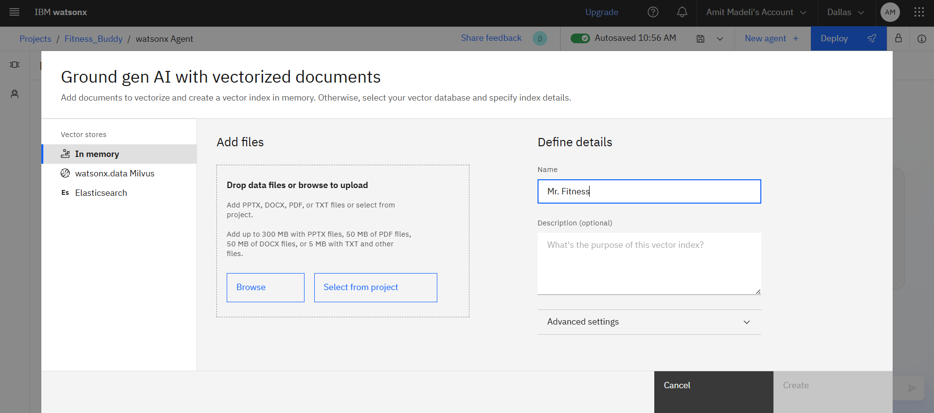
Algorithm & Deployment
Adding RAG File for AI Agent

Slide 19
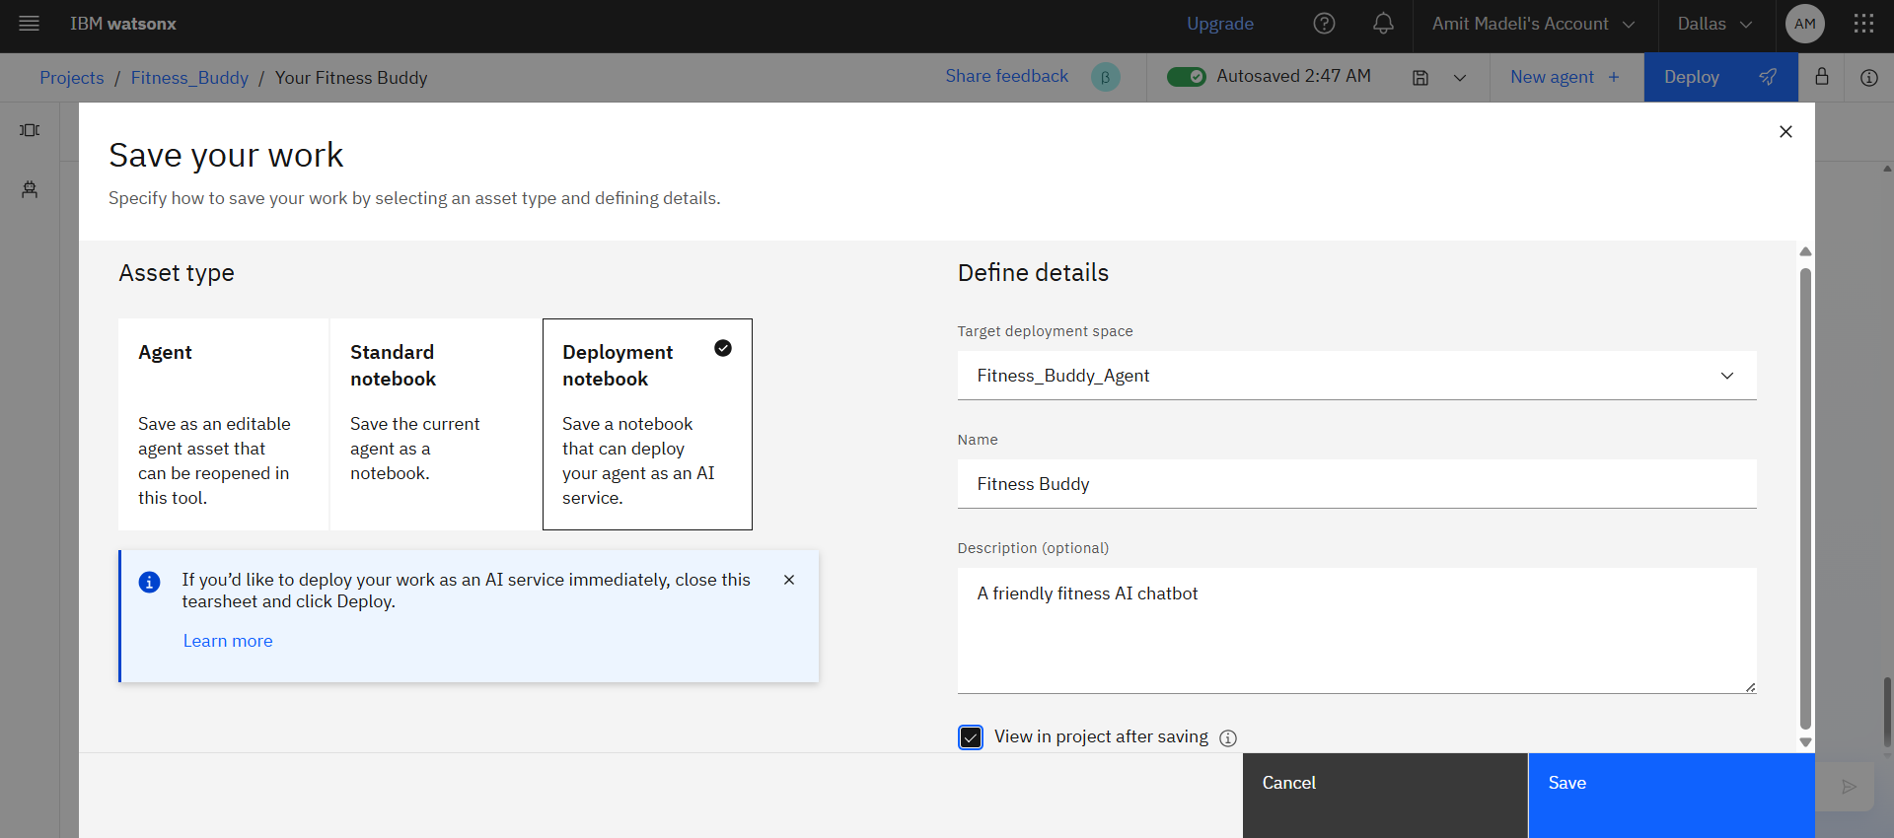
Algorithm & Deployment
Saving to Jupyter Notebook

Slide 20
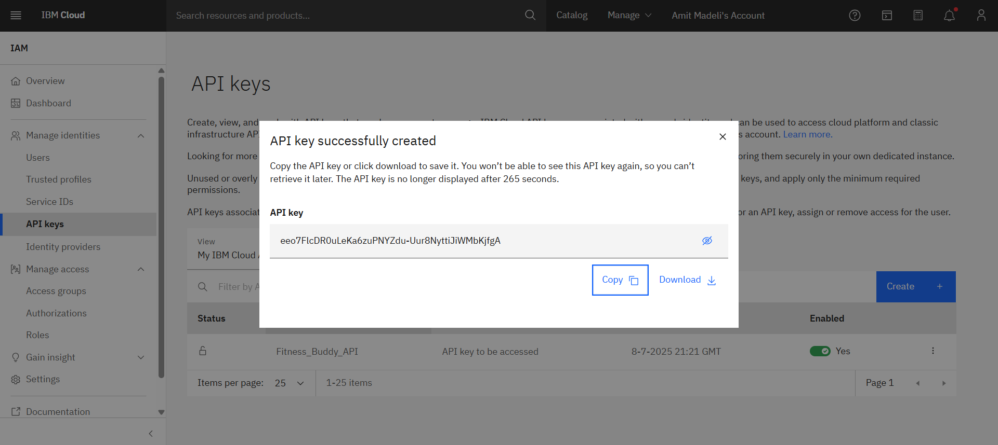
Algorithm & Deployment
Generating API Key

Slide 21
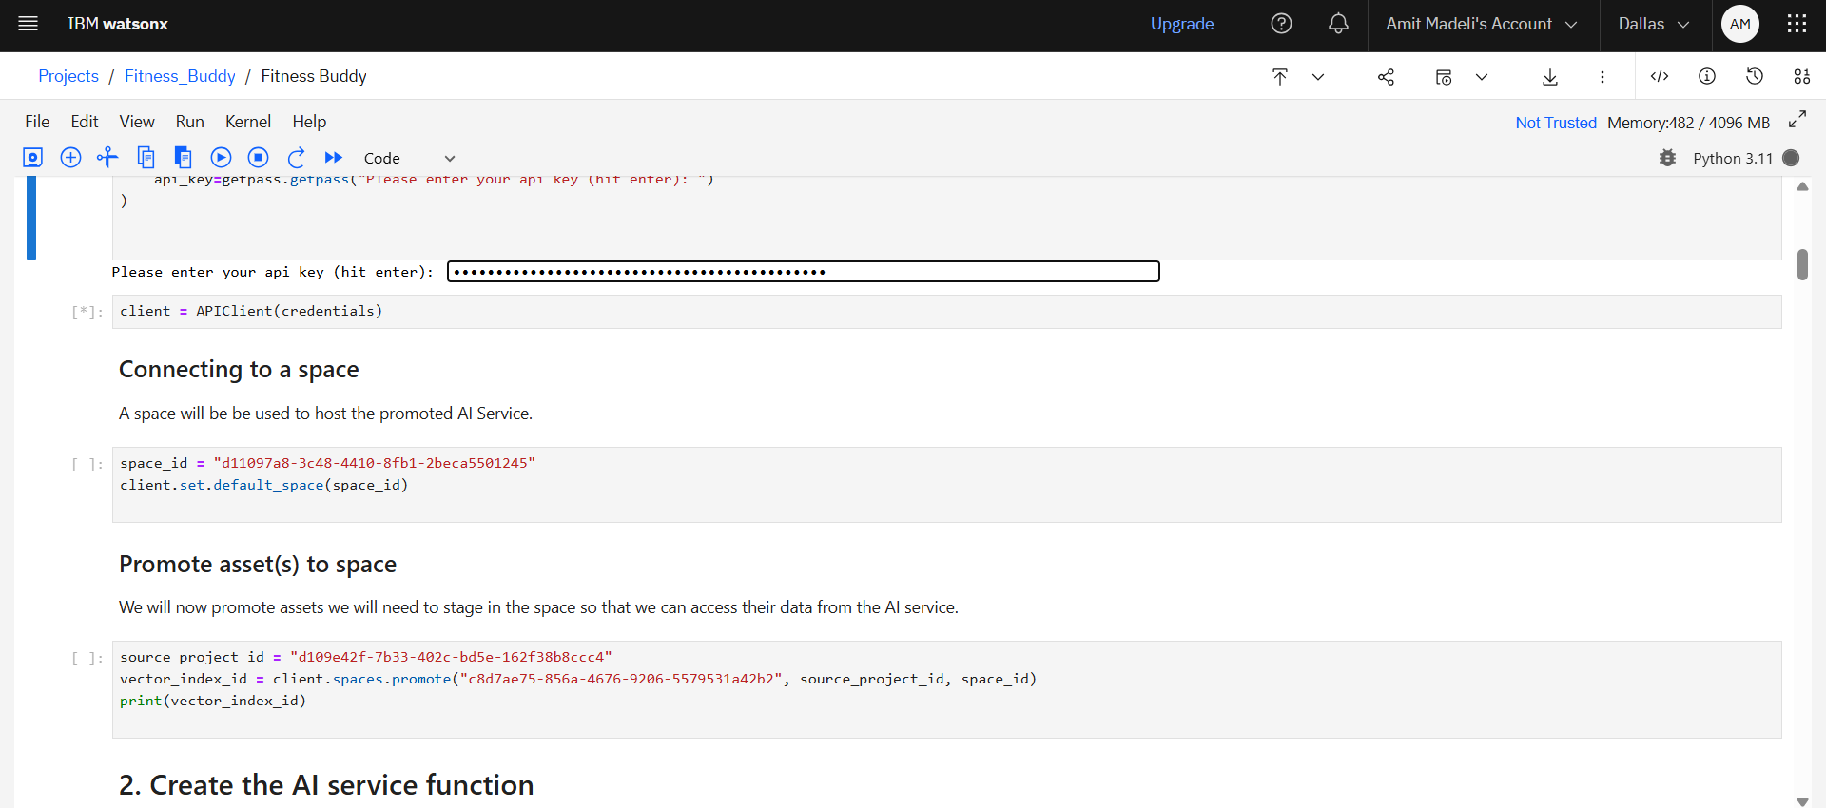
Algorithm & Deployment
Running the API key in Jupyter Notebook

Slide 22
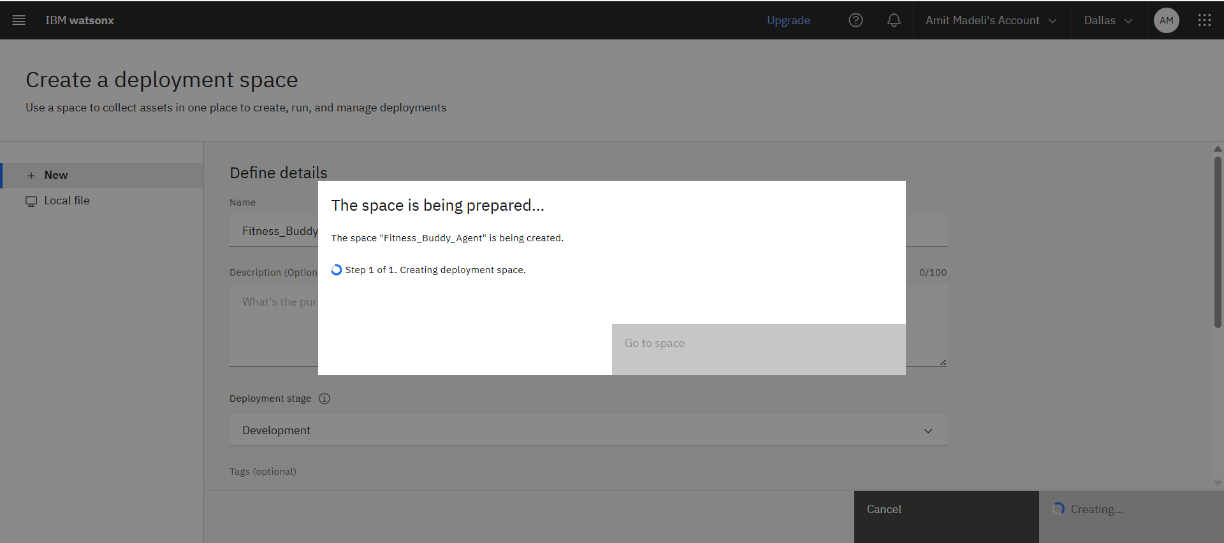
Algorithm & Deployment
Adding to Deployment Space

Slide 23
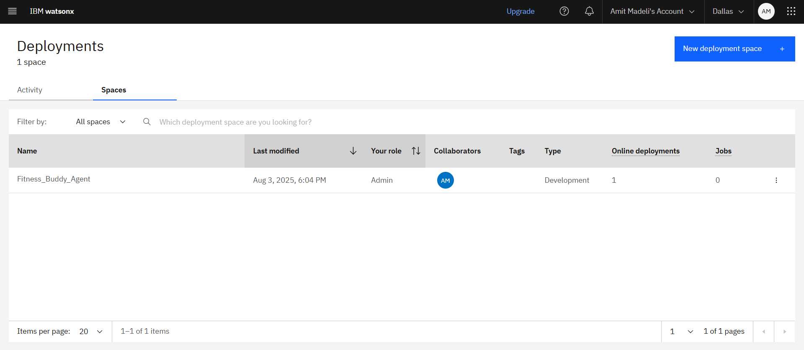
Algorithm & Deployment
Added to Deployment space successfully

Slide 24
Result
The implementation of the Fitness Buddy AI assistant using IBM Granite-3.3-8B-Instruct and deployed through IBM watsonx.ai on IBM Cloud Lite has proven successful in delivering intelligent, real-time health and wellness guidance. The system accurately interprets user inputs to generate personalized workout plans, motivational tips, and nutrition suggestions.
Initial testing showed high user engagement and positive feedback, particularly for the assistant’s ability to adapt to different fitness levels (beginner, intermediate, advanced) and goals (weight loss, strength, endurance). The assistant maintained low latency and cross-platform usability via the cloud deployment. Feedback metrics indicate improved consistency in users' workout habits and satisfaction with meal recommendations.
The project effectively demonstrates how a large language model can serve as a supportive tool for promoting healthier lifestyles in a scalable and accessible way.

Slide 25
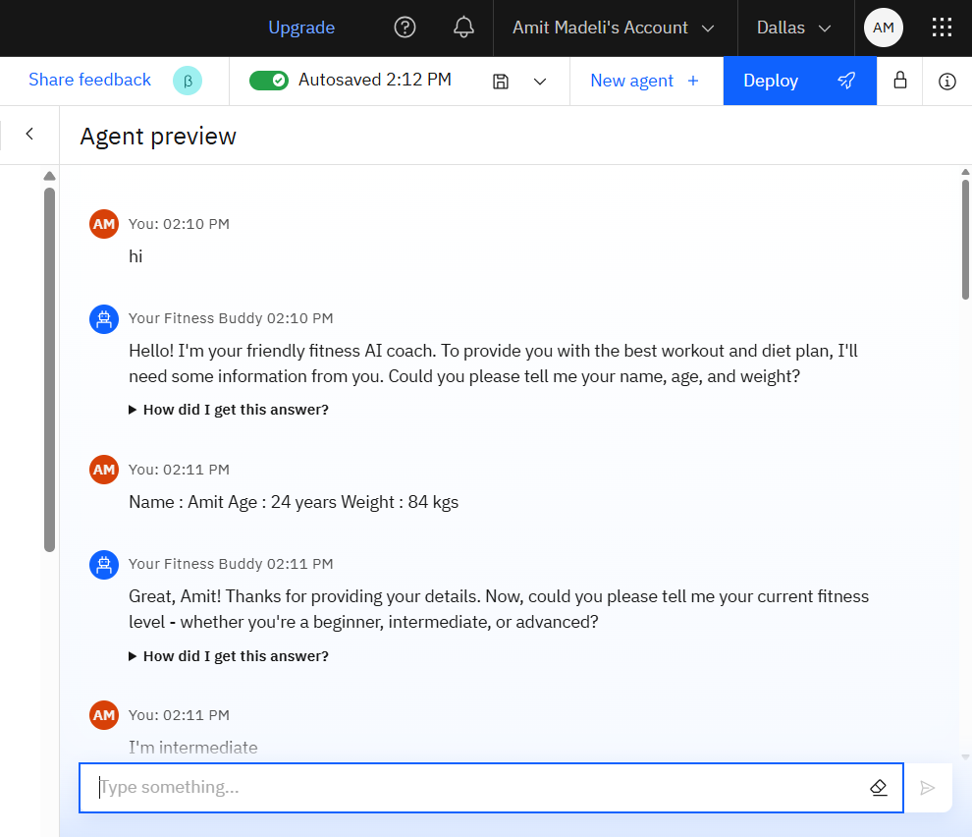
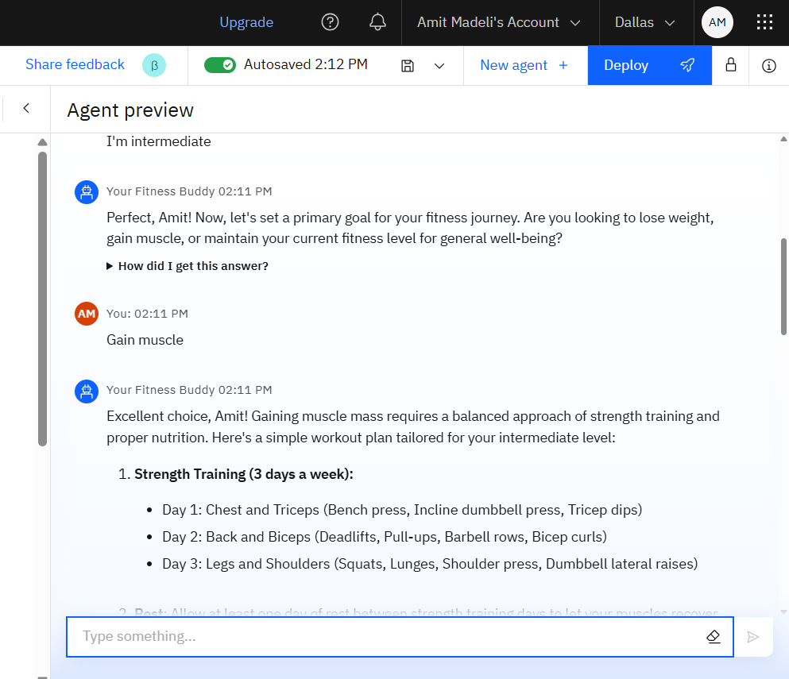
Result
Chat Response

Slide 26
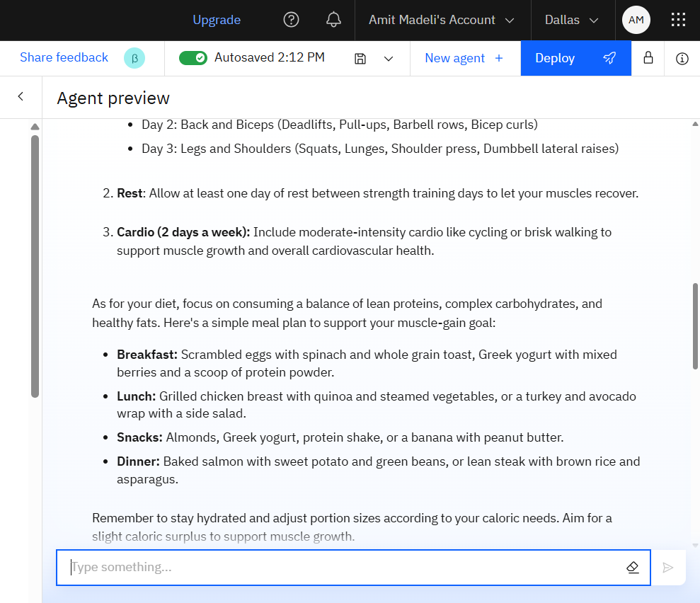
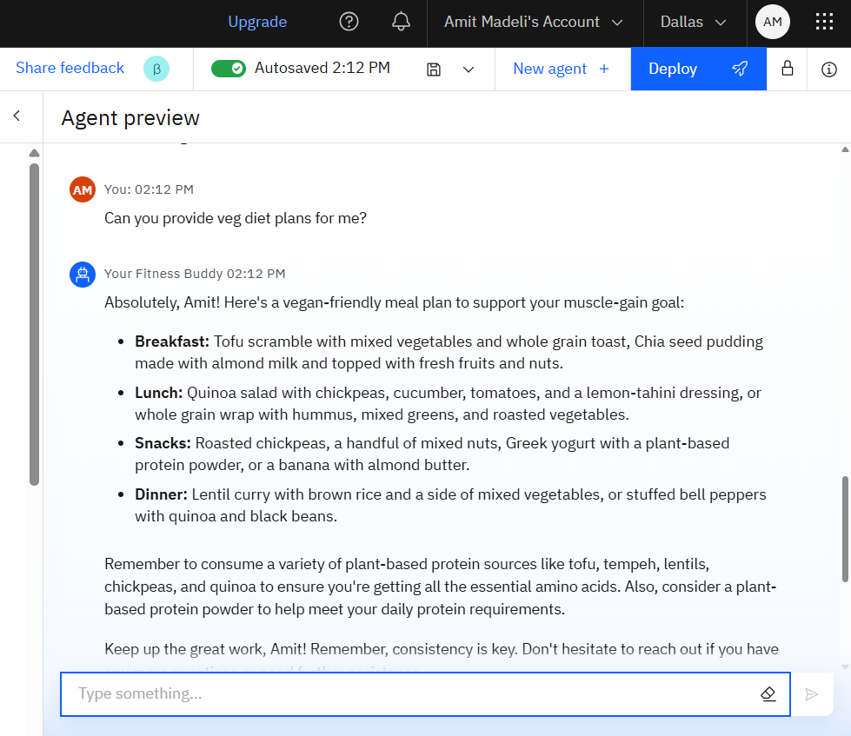
Result
Chat Response

Slide 27
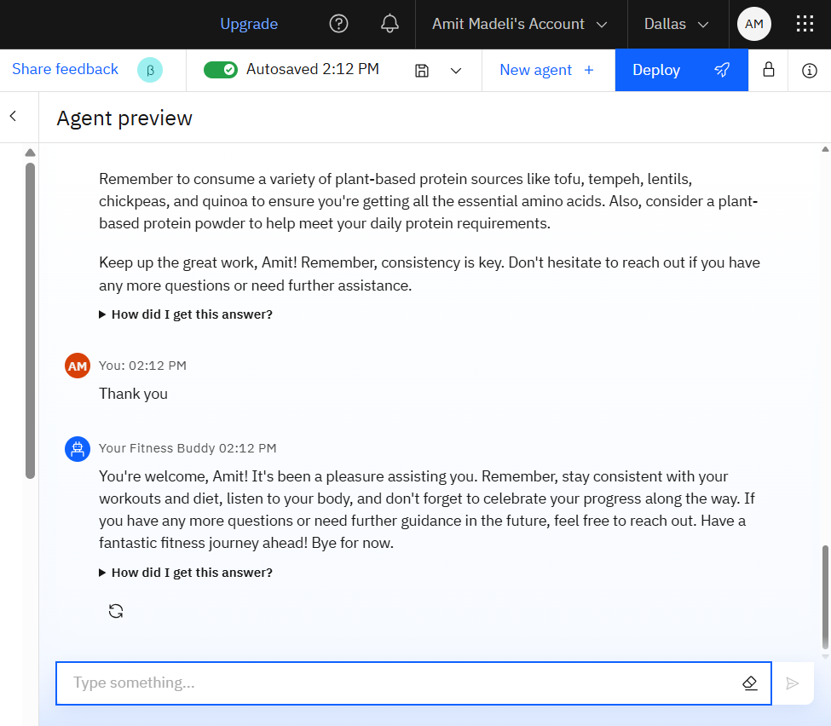
Result
Chat Response

Slide 28
Conclusion
The Fitness Buddy project addresses the critical challenges of personalized health support by offering an always-available, AI-powered assistant. Utilizing IBM Granite LLM and cloud technologies like watsonx.ai and Watsonx Runtime Studio, the system delivers custom fitness and nutrition guidance with conversational ease.
Unlike rigid traditional solutions, Fitness Buddy adapts to individual routines and preferences, making fitness more approachable. It not only assists with workouts and meals but also encourages consistency and motivation through smart interaction.
This project showcases the practical potential of deploying LLM-based virtual assistants in health tech, opening doors to further enhancements such as wearable integrations, habit tracking, and even mental wellness support in future versions.

Slide 29
Future scope
The Fitness Buddy project lays the foundation for a scalable and intelligent virtual fitness assistant. In the future, several enhancements can be made to expand its functionality and impact:
Integration with Wearables: By connecting with fitness trackers and smartwatches, the system can provide real-time feedback based on heart rate, steps, sleep, and calorie burn.
Progress Tracking & Goal Setting: Implementing visual dashboards to track user progress and set daily, weekly, or monthly goals can boost motivation and long-term engagement.
Voice Assistant Integration: Enabling voice-based interaction through platforms like Alexa or Google Assistant can improve accessibility and user convenience.
Mental Wellness Support: Adding features like guided meditation, stress relief exercises, and mood tracking to support holistic well-being.
Multilingual Support: Expanding the model to support multiple languages would make the assistant more inclusive and globally accessible.
Personalized AI Agents: Leveraging more advanced agentic AI models to remember user preferences, adjust routines over time, and provide proactive, contextual suggestions.
With these future enhancements, Fitness Buddy can evolve into a comprehensive digital health companion that supports physical, nutritional, and mental wellness for users worldwide.

Slide 30
References
IBM watsonx.ai Studio – IBM’s cloud-based platform for building, training, and deploying AI models. https://cloud.ibm.com/services/data-science-experience/crn%3Av1%3Abluemix%3Apublic%3Adata-science-experience%3Aus-south%3Aa%2Fabd9b50986ce4edbaf459913c628c789%3A6533787b-1c64-4b78-88bc-0fd00f6a3e84%3A%3A?paneId=manage
IBM Granite Models – Instruction-tuned large language models designed for enterprise-grade natural language understanding and generation. https://www.ibm.com/granite
Watsonx Runtime Studio – Execution environment for running LLMs and AI agents over the IBM Cloud. https://cloud.ibm.com/services/pm-20/crn%3Av1%3Abluemix%3Apublic%3Apm-20%3Aus-south%3Aa%2Fabd9b50986ce4edbaf459913c628c789%3A699225e8-6da9-4c28-b4c8-211b26ce694f%3A%3A?paneId=manage
Agentic AI – A design paradigm for AI systems where agents exhibit autonomous behavior to accomplish goals using tools and memory. https://www.ibm.com/think/topics/agentic-ai
Cloud Deployment on IBM Cloud – Used to host and scale the Fitness Buddy application securely and efficiently. https://cloud.ibm.com/objectstorage/crn%3Av1%3Abluemix%3Apublic%3Acloud-object-storage%3Aglobal%3Aa%2Fabd9b50986ce4edbaf459913c628c789%3A2ec961e2-d77f-499d-920a-5b0e1a2138ce%3A%3A

Slide 31
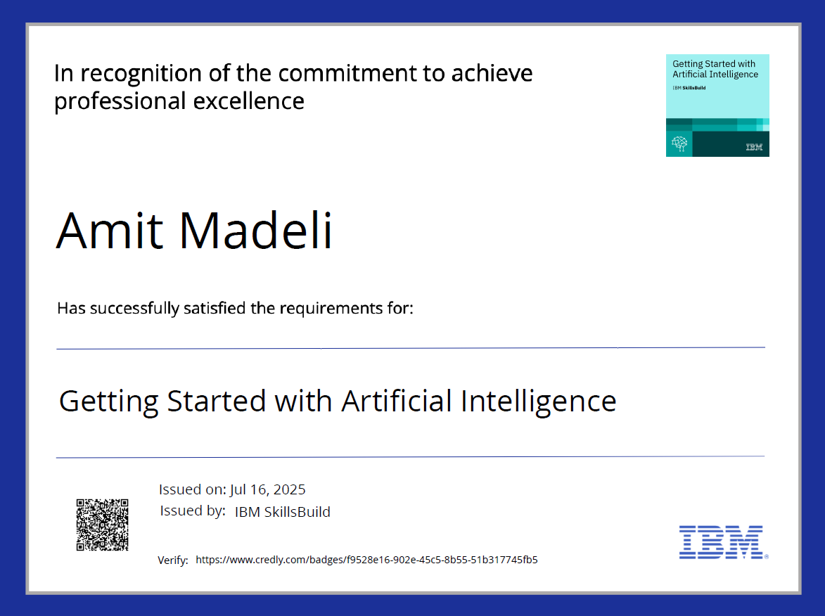
IBM Certifications

Slide 32
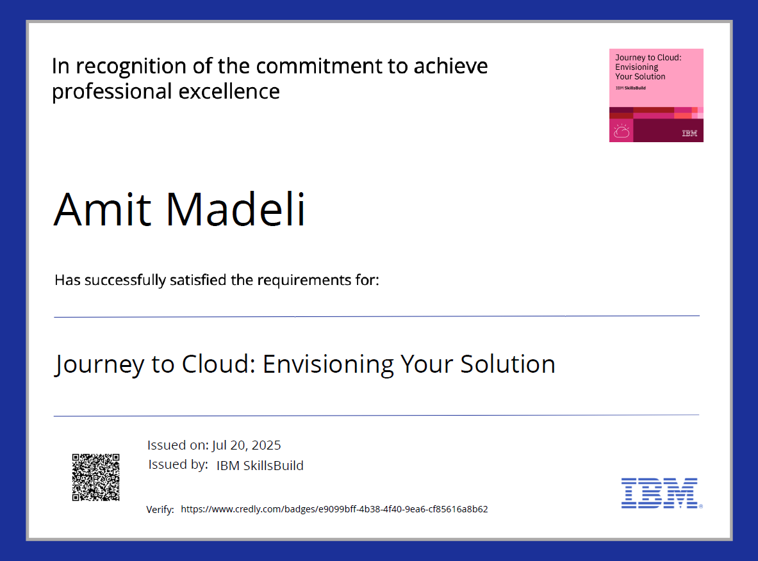
IBM Certifications

Slide 33
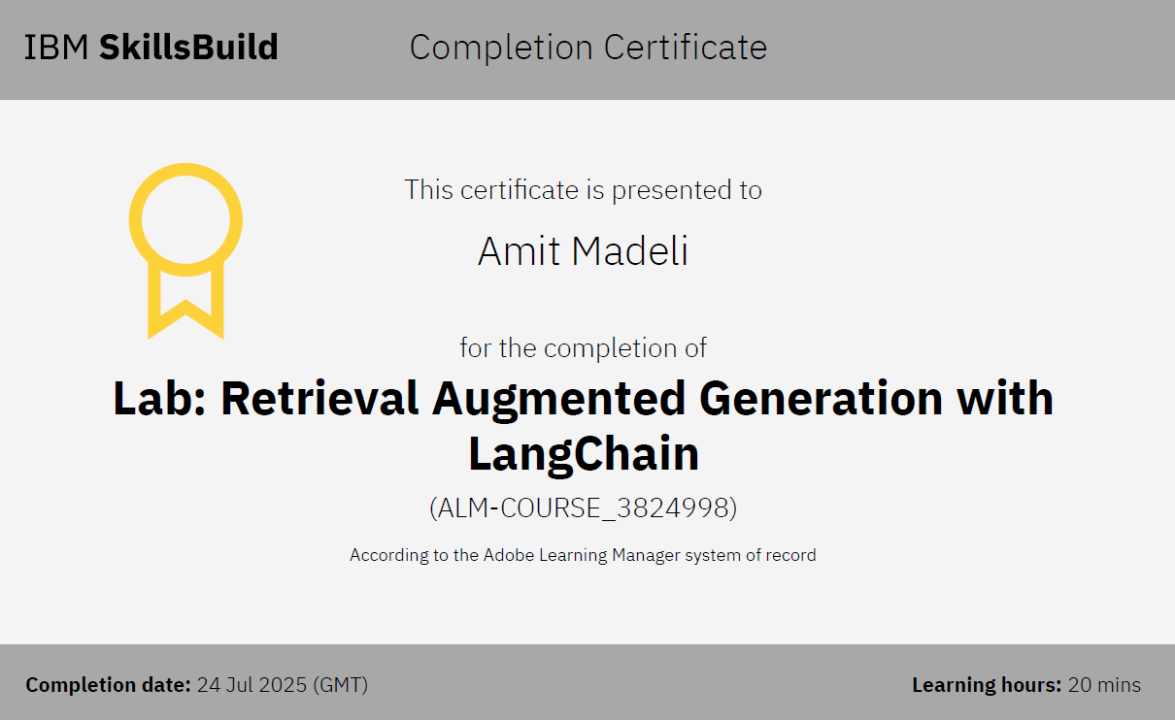
IBM Certifications

Slide 34
THANK YOU

